Slide 1

AN EVIDENCE BASED APPROACH FOR STRATEGIC PLANNING IN THE ENVIRONMENT SECTOR
Helen Watts, Rob Richards, Mat Silver (EEA)
and Carolyn Raine, Steve Pearson (CWCMA)

Slide 2
Outline
A snapshot of EBP in the environment sector
The application of EBP within the Central West Catchment Management Authority (CWCMA)
  An outsiders perspective
  An insiders perspective
Questions & discussion

Slide 3
Evidence Based Practice
Ensuring decisions and practices are based on evidence
Key is understanding the cause and effects and influencing factors
  - i.e reduce uncertainty
Used in the medical sector for over 35 years
Research evidence
Community experience and values
Practitioner M&E and experience

Slide 4
EBP in the NRM Sector
Adoption of EBP in the environmental sector?
  Centre for Evidence Based Conservation (CEBC)
  Systematic Review
Australian examples - emerging
  Environmental flows and EEA synthesis
  NRM planning, investment and evaluation

Slide 5
The 3 phases of change in Central West
Implemented landholder monitoring
Program logics & training
Project plans that incorporated MER
Incorporate EBP in CAP upgrade
Questioning what is required
Development of systems
Increasing sophistication
Permanent M&E officer appointed
Scoping study for MER requirements
MER strategy developed
Evidence Plan developed
Increased awareness of EBP & evaluation

Slide 6
Focus on the third phase
Step in EBP cycle | Tools and processes
What evidence do we need? | Evidence plan (incorporates all business questions)
What do we have & where is it? | An on-line evidence library
Invest in new evidence based on priorities | Prioritisation based on risk
Evidence bases | Search and synthesis Evaluations of priority projects
Using evidence | CAP upgrade Program design M&E design

Slide 7
An outsiders view of the enablers
Strong internal drivers for best practice
Stability in key positions
  M&E Officer
  Senior management
A culture for continuous improvement
  Increase in use and realisation of benefits with staff
Shared vision & interest in progress

Slide 8
The journey from the inside
EBP not part of Natural Resource Management
Huge problems with very little resource
EBP brings greater certainty to NRM in the CMA
  Quality of evidence and confidence is clear
  Decisions more defensible and robust
Risk assessment can be applied to evidence and resource management
Return to basic rules of hypothesis testing

Slide 9
How the CMA are using EBP
Development of Evidence Plan for CMA Business
Prioritise Monitoring and Evaluation Investment
Apply Adaptive Management to all Business
  Test assumptions (assume you are wrong)
  Document and repeat successes
  Learn and adapt from failures
Quality Value for Money Investment in NRM

Slide 10
Thank you and discussion www.environmentalevidence.com.au www.cw.cma.nsw.gov.au

Slide 11
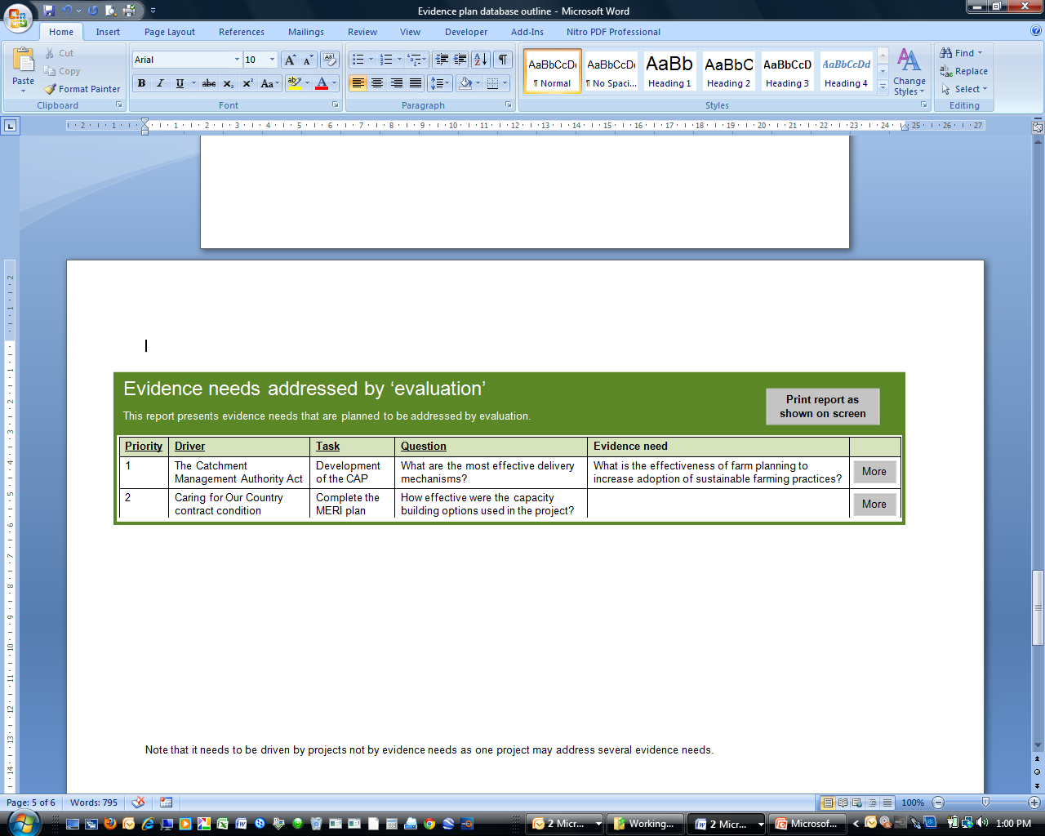
Evidence planner
The evidence planner is a simple database aimed at assisting organisations to identify what evidence is needed for organisation decisions, prioritise evidence needs requiring more evidence and plan for how priority needs will be addressed.
View evidence needs addressed by
View evidence needs associated with
All mechanisms
All drivers
Add new evidence needs

Slide 12
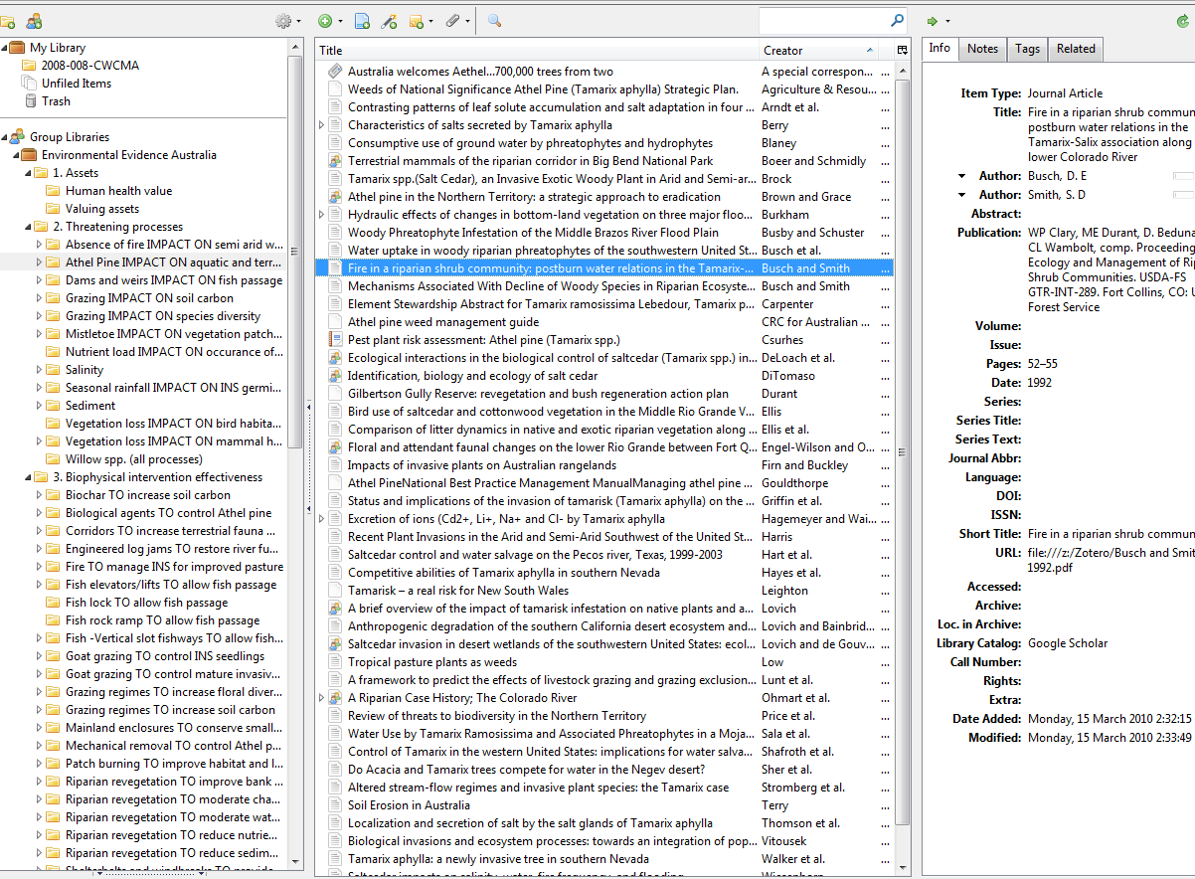

Slide 13
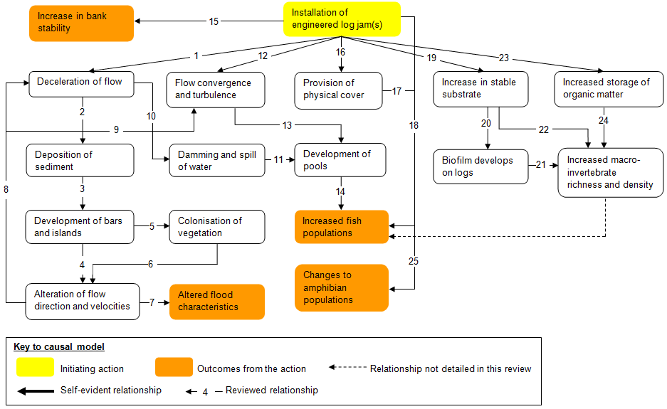
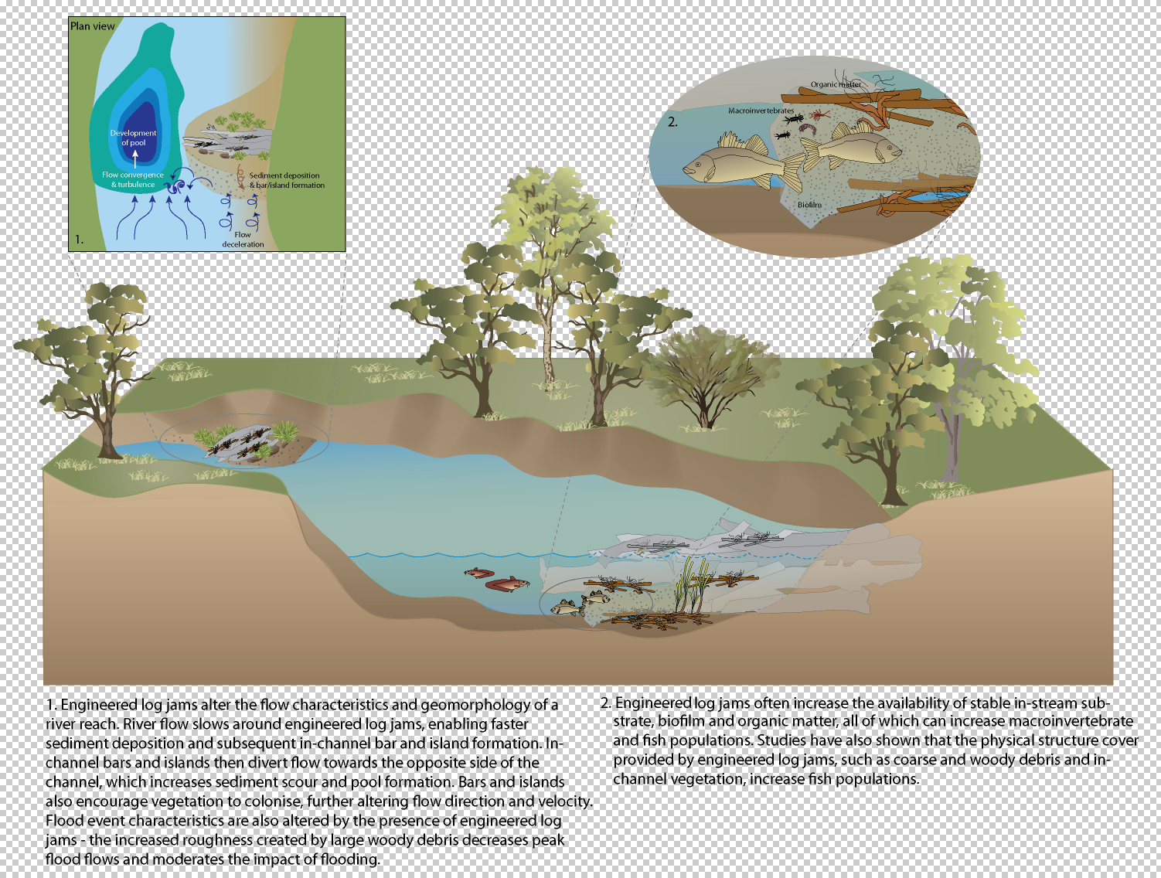

Slide 14
